Slide 1



AWS Foundation
Introduction to Load Balancing, Auto scaling & Route 53
Notes:
Welcome back to the forth module of data science.

Slide 2
Agenda
1
Introduction to Elastic Load Balancer
7
Cross Zone Load Balancing
12
13
Instance termination
2
Types of ELB - Classic, Network and
8
Introduction to Autoscaling
14
Using Load Balancer with Auto Scaling
Vertical and Horizontal Scaling
Pre-Route53: How DNS works, A Name record, CNAME, Alias and Latency
3
Load Balancer Architecture
9
15
4
Demo 1
10
Lifecycle of Autoscaling
16
Routing Policy
5
Demo 2
11
Components of Autoscaling
17
Route53 Terminologies
6
Demo 3
9
Vertical and Horizontal Scaling
18
Quiz

Slide 3
Introduction to ELB

Slide 4







Load Balancer
Load balancer is a service which uniformly distributes network traffic and workloads across multiple servers or cluster of servers. Load balancer increases the availability and fault tolerance of an application.

Slide 5

Elastic Load Balancer
Elastic Load Balancer (ELB) is a Load balancing service for the AWS deployments.
ELB scales the load balancer itself as necessary to handle the load.
Incoming traffic is distributed across EC2 instances in multiple Availability Zones.
Load balancer is the single point of contact for clients.

Slide 6
Types of Elastic Load Balancer (ELB)

Slide 7
Types of Elastic Load Balancer (ELB)
Classic Load Balancer
It resembles traditional load balancing, but virtual devices replace the physical hardware.
Network Load Balancer
This is used for handling sudden and violent site traffic.
Application Load Balancer
Identifies the incoming traffic type and directs it to that specific resource.

Slide 8



Classic Load Balancer
Distributes incoming application traffic across ec2 instances in multiple AZs. Functions at Layer 7 (OSI Model).
Routes traffic to healthy instances only. Evenly distributed.
Internet and Internal Facing Load Balancer.
Availability Zone A
Availability Zone B

Slide 9
Network Load Balancer
Network load balancer functions at the 4th layer of the OSI model
It can handle millions of requests per second and maintain low latency
Ideal for load balancing TCP traffic and also supports elastic or static Ip
Availability Zone A
Availability Zone B

Slide 10

Application Load Balancer
Application load balancer functions at the 7th layer of the OSI model
Identifies the incoming resource type and directs it to
Availability Zone A
Availability Zone B

Slide 11
Load Balancer Architecture

Slide 12

Load Balancer Architecture
pub-subnet
priv-subnet
us-east-1b
pub-subnet
priv-subnet
us-east-1a

Slide 13
Demo 1

Slide 14
Demo 1: Creating Load Balancers
Classic Load Balancer Creation
Open AWS Management Console, click on the Services drop down box and choose EC2
Scroll down and choose “Load Balancers”
Choose create load balancer and choose Classic
Configure all the settings one by one – Give a name, create a new VPC, Add a tag, then choose review and launch
Review (optional) and choose launch
Classic load balancer is created

Slide 15
Demo 2

Slide 16
Demo 2: Creating Load Balancers
Network Load Balancer Creation
Open AWS Management Console, click on the Services drop down box and choose EC2
Scroll down and choose “Load Balancers”
Choose create load balancer and choose Network
Configure all the settings one by one – Give a name, create a new VPC, Add a tag, then choose review and launch
Review (optional) and choose launch
Network load balancer is created

Slide 17
Demo 3

Slide 18
Demo 2: Creating Load Balancers
Application Load Balancer Creation
Open AWS Management Console, click on the Services drop down box and choose EC2
Scroll down and choose “Load Balancers”
Choose create load balancer and choose Application
Configure all the settings one by one – Give a name, create a new VPC, Add a tag, then choose review and launch
Review (optional) and choose launch
Application load balancer is created

Slide 19
Cross Zone Load Balancing

Slide 20
Cross-Zone Load Balancing
CLB DNS
By default CLB nodes distributes traffic to instances in its availability zone only.
Enable cross-zone load balancing to route evenly across EC2 instances.
Routes each request to the instance with smallest load.
us-east-1a
us-east-1b

Slide 21
Introduction to Autoscaling

Slide 22

Introduction to autoscaling
Scaling is adding or removing capacity/resource as needed.
Scale Out is adding capacity/resources.
Scale In is removing capacity/resources.
Types: Vertical and Horizontal.

Slide 23

Introduction to autoscaling
Scaling Types: Vertical and Horizontal
Vertical
CPU: 2.0GHz to3.2 GHz
RAM: 1024GB to 2048GB
N/W Bandwidth: 4Gbps to 10Gbps
Horizontal
CPU: 1 server with 1.0GHz to 3 servers with 1.0GHz
RAM: 1 server with 500GB to 3 servers with 500GB

Slide 24
Introduction to autoscaling
Auto Scaling is scaling out or in automatically without any manual intervention.
Helps to ensure correct no of ec2 instances are available to handle load.
Multi-AZ ec2 instances provide high available solution.
Auto Scaling can dynamically increase and decrease capacity as needed.

Slide 25
Vertical and Horizontal Scaling

Slide 26



Horizontal Scaling
Horizontal Scaling
Increase in website traffic

Slide 27
Vertical Scaling
Vertical Scaling
Increase in website traffic

Slide 28
Lifecyle of Autoscaling

Slide 29
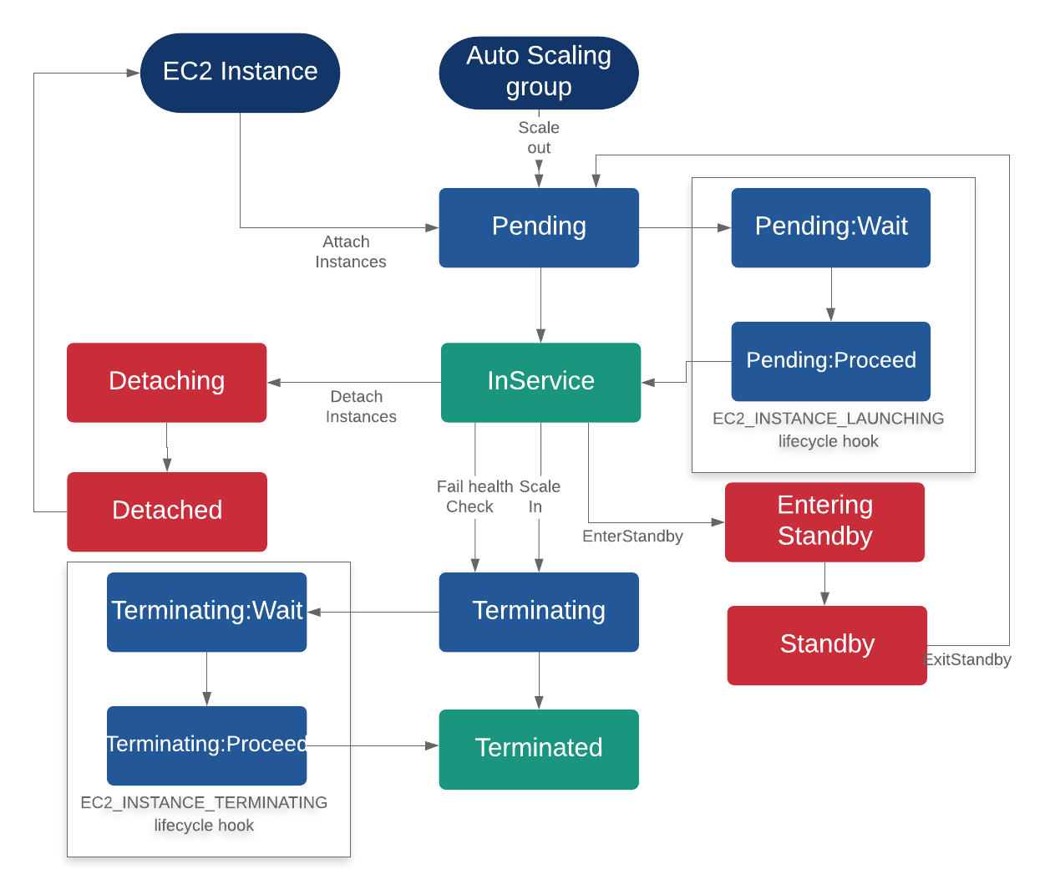
Lifecycle of Autoscaling

Slide 30
Components of Autoscaling

Slide 31



Autoscaling Components
Groups
EC2 instances are in groups so that they can be considered as an logical unit (For Scaling and Management)
When you create a group, you can mention these attributes – Max, Min and desired number of instances
These are used as configuration templates for the EC2 Instances.
Launch template or Launch configuration is also used.
Scaling options
Autoscaling provides several ways to scale the group
Manual Scaling
Dynamic Scaling
Scale based on demand or schedule
Configuration Templates

Slide 32

Autoscaling Groups
Auto Scaling group contains a collection of EC2 instances that are exactly same.
While creating an Auto Scaling group, launch configuration must be specified.
After specifying, the launch configurations cannot be changed.
New instances are launched using new configuration.
EC2 instances are launched and terminated using scaling policies.

Slide 33
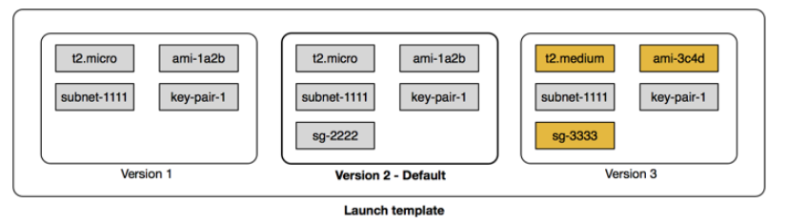
Configuration Templates
Launch template can also be used with auto scaling groups.

Slide 34
Configuration Templates
Launch configuration is a template that is used to launch EC2 instances for Auto Scaling purpose.
Auto scaling groups (next topic) uses launch configuration to launch instances.
Launch Configuration cannot be modified after creation.
Can be created in two ways
From scratch – Image ID, instance type, storage devices etc.
From an EC2 instance – Attributes from the instance are copied over. Block device mapping of the AMI is included, any additional devices which were attached after launching the instances are not considered in the launch configuration.

Slide 35
Scaling Options (Dynamic Scaling)
Scaling policies and Alarms.
Scaling policies mention how to scale, and alarms decide when to scale.
CloudWatch alarms are set to monitor individual metrics, e.g. CPU Utilization etc.
When the threshold is breached, scaling policies are executed.
Minimum, Maximum and Desired capacity.
Scaling Policy:
INCREASE 2 instances at a time
DECREASE 1 instance at a time
Alarm:
IF CPU Utilization > 80% for more than 10 mins, ring the bell
Minimum Capacity – 2
Desired Capacity – 4
Maximum Capacity - 10

Slide 36
Other Scaling Options
Scale based on a schedule – This type of a scaling method is used to scale at a given time and date.
Scale based on a demand – Scaling occurs when the CPU utilization of the current running instances grow beyond a fixed usage limit.
Scale based on schedule:
INCREASE the instances by 2 at 2:30 pm Today
DECREASE the instances by 1 at 12:00 am Tomorrow
Scale based on demand:
IF CPU Utilization > 80% for more than 10 mins, INCREASE the instance by 1
IF CPU Utilization < 50% for more than 5 mins, DECREASE the instances by 2

Slide 37
Scaling Policy

Slide 38

Scaling Policy
Scaling Policy:
INCREASE 2 instances at a time
DECREASE 1 instance at a time
Alarm:
IF CPU Utilization > 80% for more than 10 mins, ring the bell
Minimum Capacity – 2
Desired Capacity – 4
Maximum Capacity - 10

Slide 39
Scaling Policy

Slide 40
Scaling Policy
Cool-down period - Simple Scaling Policy
Cool-down period – Ensures that Auto Scaling does not launch or terminate any more instances until a specified time period is completed. Scaling activity is suspended until cool-down period is in effect.

Slide 41
Scaling Policy
Step Scaling
CPU | Add
> 60% | 2
> 75% | 3
> 85% | 4
Alarm: CPU > 60%. Action: Add 2 Instances.
85
75
60

Slide 42
Instance Termination

Slide 43
Instance Termination
Instances in Multiple AZs ??
SCALE IN
Select AZ with most instances
YES
NO
Select instances with oldest launch configs
A
Connector

Slide 44
Instance Termination
Multiple instances using oldest Launch Config ??
A
NO
YES
Select instances closest to next billing hour
Multiple instances closest to next billing hour ??
YES
Select instances at random
Terminate Instance

Slide 45

Instance Termination
Termination Policies (Other than DEFAULT)
Oldest Instance
Newest Instance
Oldest Launch Configuration
Closest To Next Instance Hour
Instance protection does not terminate an instance during a scale in event. Can be enabled at Auto Scaling group or individual instance level.

Slide 46
Autoscaling Pricing
No Additional fees.
Underlying instances are charged hourly.
Visit https://aws.amazon.com/autoscaling/pricing/ for details.

Slide 47

Autoscaling Design Patterns
Design Patterns
Front End
Back End
Database
Front End
Back End

Slide 48
ELB & AS Integration

Slide 49
ELB & AS Integration
Auto Scaling: Adds and removes capacity as per requirement.
Load Balancer: Distributes incoming traffic evenly across all EC2 instances.
Putting ELB in front of AS makes sure that all incoming traffic are distributes across dynamically changing number of EC2 instances.
ELB is the point of contact between clients and backend ec2 instances.

Slide 50
ELB & AS Integration
Load balancer automatically registers instances in the group.
Health Checks
EC2 instance only – EC2 status checks are considered.
EC2 and ELB health checks – An instance is considered unhealthy if either of the health checks fail.
ELB
Auto Scaling

Slide 51
Pre-Route53

Slide 52





What is Route53?
Route53 is highly available and scalable Domain Name System provided by AWS.

Slide 53
Domain Name System
www.amazon.com –
“com” – Top Level Domain Name.
“amazon” – Domain Name.
Domain Name System is an internet service that translates Domain Names into IP Addresses.
ROOT servers keep information about TLD servers.
TLD servers keep information about authoritative Name Servers.
Your Computer
ISP DNS Resolver
Name Servers contain information about IP addresses for individual domains.
ROOT Server
TLD server for .com
DNS server

Slide 54
DNS Hierarchy
Root
edu
com
org
gov
TLD
Domain
test.com
amazon.com
example.com

Slide 55


Hosting your Website
Step 1 – Start up a server/host where web service will run (Say IP Address of the server is 10.20.30.40).
Step 2 – Get a domain name from domain name providers like GoDaddy, freenom etc.
Step 3 – Link Domain name with IP address from Step 1 using Domain Name Service/System.
www.example.com | 10.20.30.40

Slide 56
DNS Literature
Authoritative Name Server – Server component in Domain Name System (DNS) which holds actual DNS records like A Name, CNAME, Alias etc.
“A” NAME Record – Maps Domain Name to IP Address of the backend host. “A” is for Address. A NAME record format is mentioned below:
Type | Domain/Host Name | Address | TTL
A | www.abc.com | 101.202.30.40 | 60
A | www.apple-orange.com | 54.28.14.6 | 300
AAAA | www.example.com | fe80::1cb2:373a:3dd1:8f46 | 600

Slide 57
DNS Literature
CNAME (Canonical Name) Record – Maps one name to another name instead of an IP address.
Alias Name is similar to CName record with a “little” difference.
Type | Domain/Host Name | Address | TTL
CNAME | www.fruits.com | www.apple-orange.com | 300
CNAME | www.vegetables.com | www.fruits.com | 600
A | www.apple-orange.com | 54.28.14.6 | 900
www.vegetables.com
www.fruits.com

Slide 58
DNS Literature
Type | Domain/Host Name | Address | TTL
CNAME | www.fruits.com | www.apple-orange.com | 300
CNAME | www.vegetables.com | www.fruits.com | 600
A | www.apple-orange.com | 54.28.14.6 | 900
www.fruits.com
www.apple-orange.com
54.28.14.6

Slide 59
Network Latency and Bandwidth
Network Latency is the amount of time taken to deliver some amount of data over n/w.
10 seconds
Source
Destination
?
5 seconds
Latency = 10 + 5 = 15 seconds

Slide 60
Routing Policy

Slide 61
Routing Policy
Public Hosted Zone contains information about how traffic on the Internet should be routed for a Domain.
NS record set – Authoritative Name Servers for Domain Name.
SOA (Start of Authority) record set – Contains base DNS information about the Domain.
ns-2048.awsdns-64.net: Host that created the SOA record.
hostmaster.example.com: email address of the admin with “@” being replaced by “.”
86400: Minimum TTL.
Private Hosted Zone contains information about how to route traffic for a Domain within one or more VPCs.
Note: To use Private hosted zones, following VPC settings have to be set to TRUE.
enableDnsHostnames
enableDnsSupport
ns-2048.awsdns-64.net. hostmaster.example.com. 1 7200 900 1209600 86400

Slide 62

Routing Policy
Simple Routing Policy – Single server performing the desired operation.
Route53
EC2

Slide 63

Routing Policy
EC2
Failover Routing Policy – Two servers performing the Active-Passive routing.
EC2

Slide 64
Routing Policy - Weighted
Associate multiple resources with the same DNS name and type.
Each Record Set is given a Weight and Set ID.
Weight: 2
2/(2+1)
1
2
EC2
1
2
3
Route53
3
Weight: 1
1/(2+1)
EC2

Slide 65
Routing Policy - Latency Based
If an application is hosted on EC2 instances in multiple regions, user latency can be reduced by serving requests from the region where network latency is lowest.
Create a latency resource record set for the Amazon EC2 resource in each region that hosts the application.
Latency record sets can be created for both ELB and EC2 instances.
Latency on the internet can change over time due to changes in routing or something else.
6.8 ms
4.2 ms
3.7 ms
Singapore
8.4 ms
www.apple-orange.com
N. Virginia
Mumbai

Slide 66
Routing Policy - Latency Based
If an application is hosted on EC2 instances in multiple regions, user latency can be reduced by serving requests from the region where network latency is lowest.
Create a latency resource record set for the Amazon EC2 resource in each region that hosts the application.
Latency record sets can be created for both ELB and EC2 instances.
Latency on the internet can change over time due to changes in routing or something else.
6.8 ms
4.2 ms
3.7 ms
Singapore
8.4 ms
www.apple-orange.com
N. Virginia
Mumbai

Slide 67
Routing Policy - Geolocation
Geolocation routing can be used to send traffic to resources based on the geographical location of the users. e.g. all queries from Europe can be routed to the IP address 10.20.30.40.
Geolocation works by mapping IP addresses, irrespective of regions, to locations.
Region: us-east-1
AZ: us-east-1b
IP: 10.20.30.40
UK
Route53
Region: us-east-1
AZ: us-east-1a
IP: 100.50.25.10
Japan

Slide 68
Quiz

Slide 69
Quiz
1. Application Load Balancer functions at which layer of OSI Model?
A. 4
B. 7
A. 1
B. 6

Slide 70
Quiz
2. Network Load Balancer functions at which layer of OSI Model?
A. 4
B. 7
A. 1
B. 6

Slide 71
Quiz
4. In Autoscaling, Schedule scaling is based on CPU Utilization?
A. True
B. False

Slide 72
Quiz
5. Route53 Weighted Routing Policy is based on the latency.
A. True
B. False

Slide 73
Quiz
6. Route53 is allowed to create alias records.
A. True
B. False

Slide 74

India : +91-7847955955
US : 1-800-216-8930 (TOLL FREE)
support@intellipaat.com
24X7 Chat with our Course Advisor
Notes:
Thank you!

